Slide 2

Protecting Cloud Identities - Using Azure MFA and Enterprise Mobility + Security (EMS)
Ronni Pedersen
Microsoft MVP: Enterprise Mobility
Twitter: @ronnipedersen
2

Slide 3


Ronni Pedersen
Freelance Cloud Architect
Microsoft MVP: Enterprise Mobility (10 years)
Founder: System Center User Group Denmark
Microsoft Certified Trainer
Contact Me
Twitter: @ronnipedersen
Blog: https://www.ronnipedersen.com/
Mail: mail@ronnipedersen.com
Phone: +45 2085 9452
About me...

Slide 4

Key Takeways
EMS Overview
Office 365 Risk Score
Privileged Identity Management
Identity Protection
Password Policies
Multi-factor authentication
Conditional Access
4

Slide 5
Enterprise Mobility + Security
Overview

Slide 6



The world has changed…
@RonniPedersen
6

Slide 7
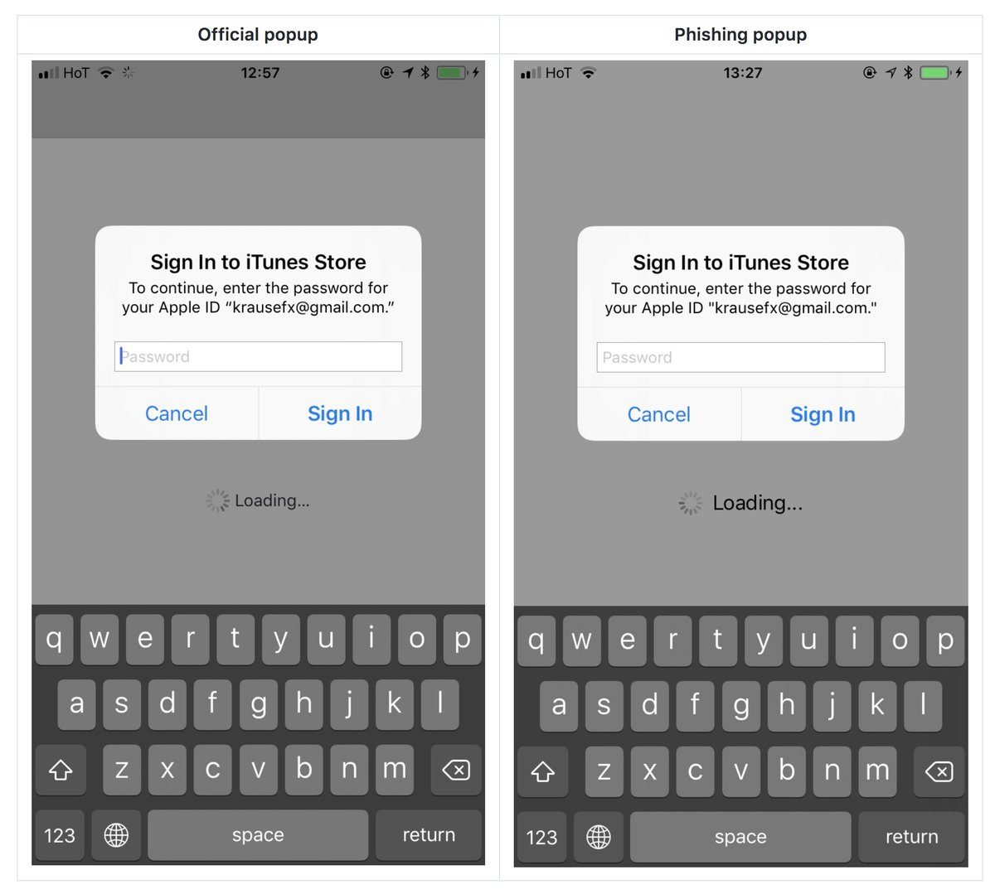
@RonniPedersen

Slide 8
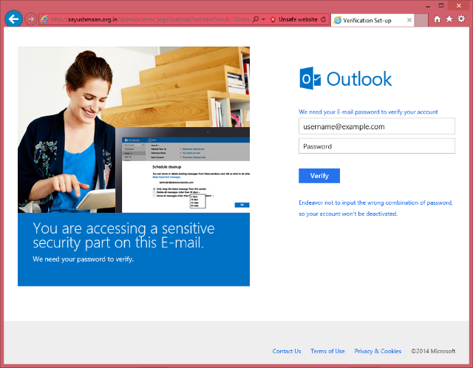
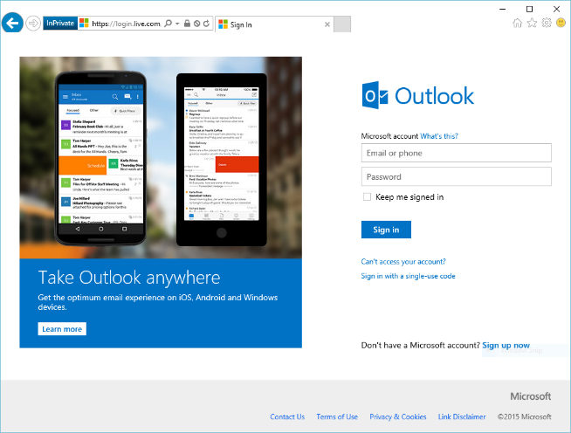
@RonniPedersen

Slide 9
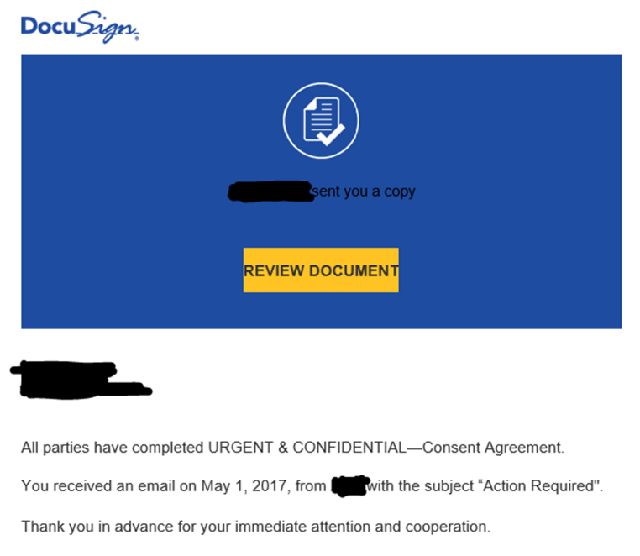
Hi… This is mom… Should I click on this?

Slide 10
Office 365 Secure Score
State of the Union…

Slide 11
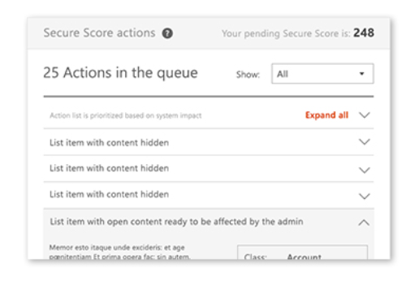
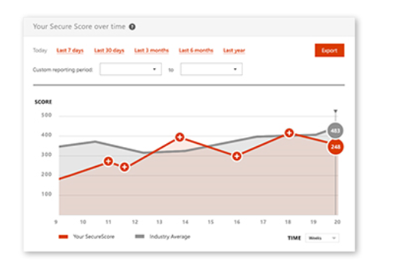
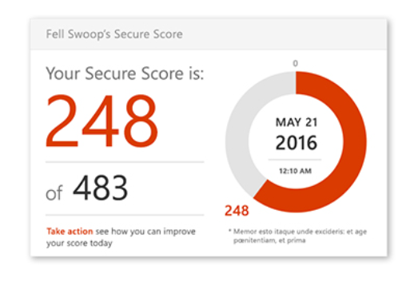
Office 365 Secure Score
Get your Secure Score
Analyzing Your Score
Take Action (Improve Your Score)
@RonniPedersen

Slide 12
Office 365 Secure Score: Mailbox Auditing in Office 365
Step 1: Connect to Exchange Online
Step 2: Get the current state of audit logging
Step 3: Enable mailbox audit logging
Step 4: Set the age limit for mailbox audit logging
Step 5: Automate the process using Azure Automation
Step by step guide:
https://www.ronnipedersen.com/2017/07/29/automate-mailbox-auditing-office-365/
@RonniPedersen

Slide 13
Azure AD Privileged Identity Management
Manage, control, and monitor access within your organization

Slide 14




Azure AD Privileged Identity Management
@RonniPedersen

Slide 15
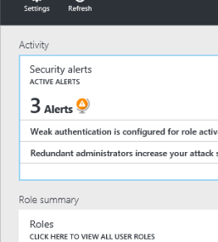
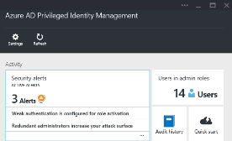
Privileged Identity Management
User
Administrator
Administrator privileges expire after a specified interval
User
Enforce on-demand, just-in-time administrative access when needed
Ensure policies are met with alerts, audit reports and access reviews
Manage admins access in Azure AD and also in Azure RBAC
@RonniPedersen

Slide 16
Azure AD Privileged Identity Management
Manage, control, and monitor access within your organization
Includes resources in Azure AD, Office 365 or Microsoft Intune
Goal: minimize the number of people who have access to secure information or resources
Enable on-demand, "just in time" administrative access to Microsoft Online Services like Office 365 and Intune
Privileged identity management requires:
Azure AD Premium P2
Enterprise Mobility + Security (EMS) E5
Microsoft E5
@RonniPedersen

Slide 17
Azure AD Identity Protection
Protect and monitor identities…
Proactively prevent compromised identities from being abused!

Slide 18

Risky Sign-in
Low
User sign-in from infected Device
Medium
User sign-in from unfamiliar locations
Impossible travel to atypical location
Sign-in from anonymous IP addresses
High
User with leaked credentials (up for sales)
@RonniPedersen

Slide 19
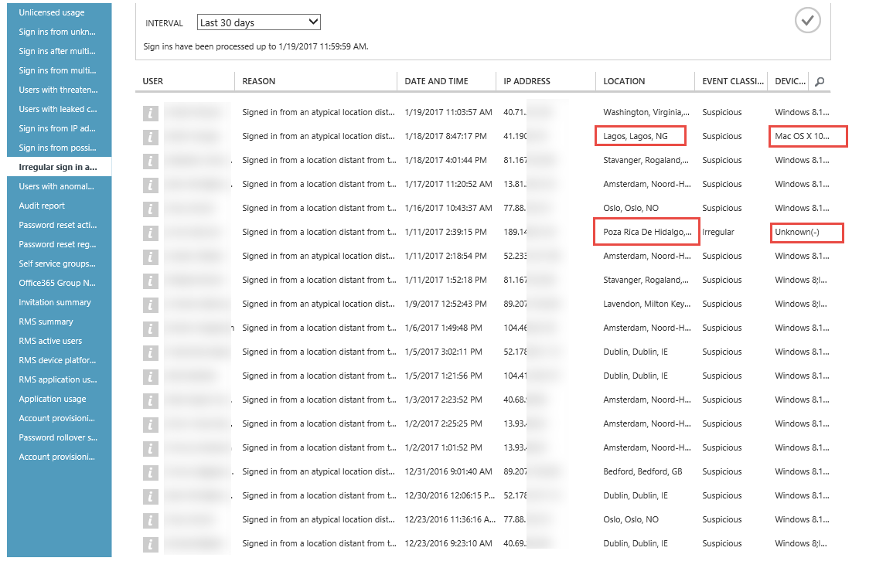
@RonniPedersen

Slide 20
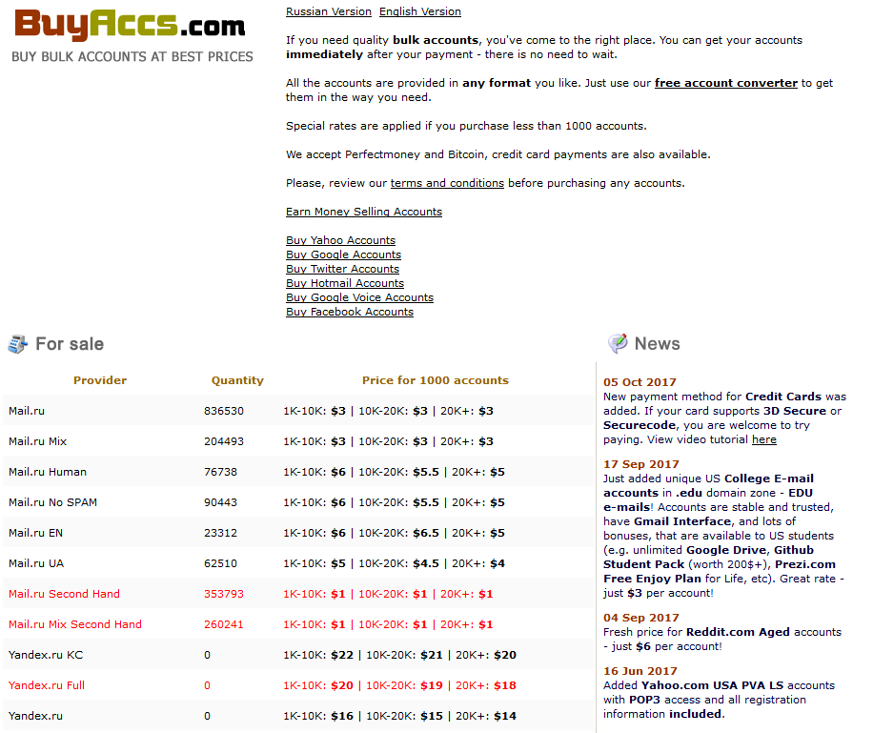
@RonniPedersen

Slide 21
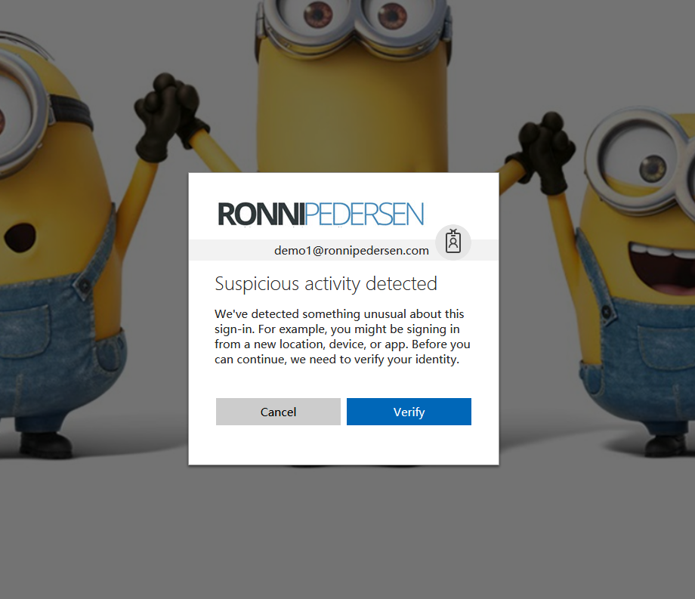
@RonniPedersen

Slide 22
Password Policies and Spray Attacks
45.000 Enterprise Accounts hacked by spray attacks in August 2017

Slide 23

#DeathToPasswords
PASSWORD SPRAY
Try common passwords against known account lists
BREACH REPLAY
Try stolen passwords from other sites
PHISH
Trick users into handing over their passwords
IF YOU HAVE PASSWORDS, YOU MUST USE MFA
@RonniPedersen

Slide 24
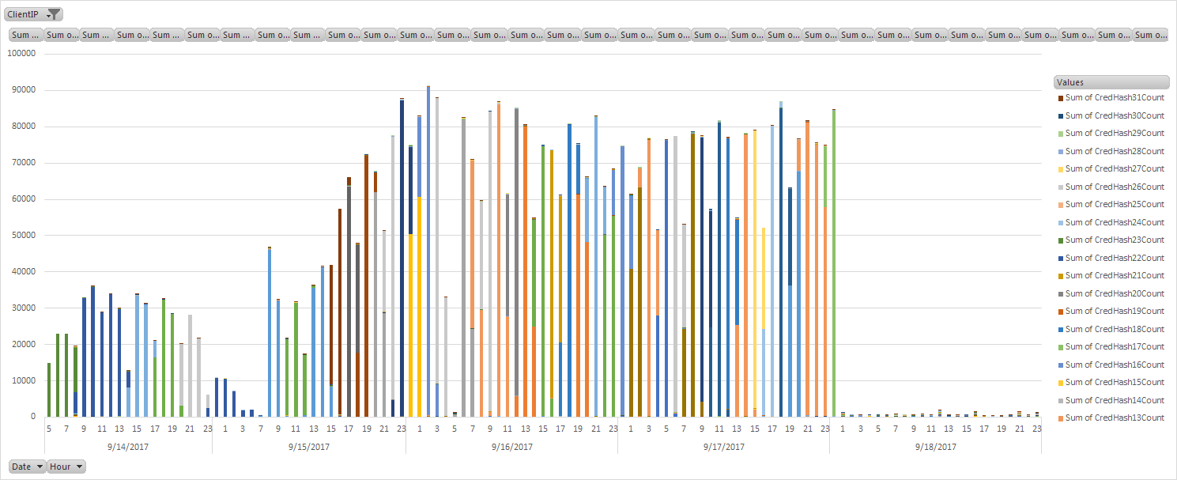
Password Spray (aka Brute Force)
123456
123456789
qwerty
111111
12345678
123123
password
1234567
12345
1234567890
abc123
123
123321
password1
qwertyuiop
666666
a123456
1234
654321
5201314
@RonniPedersen

Slide 25
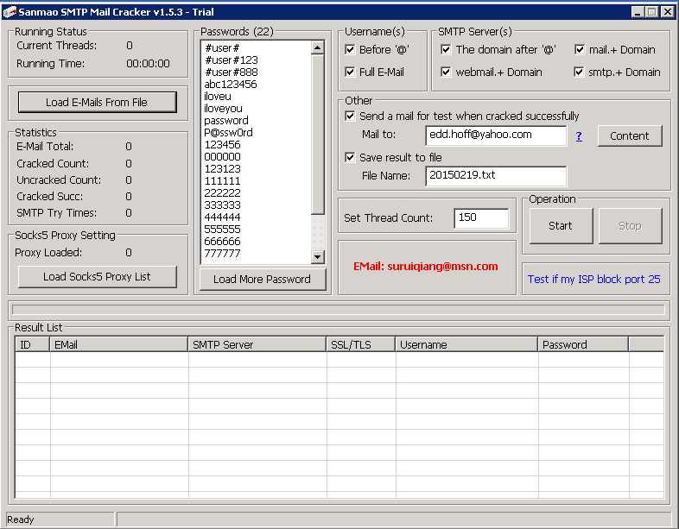
@RonniPedersen

Slide 26
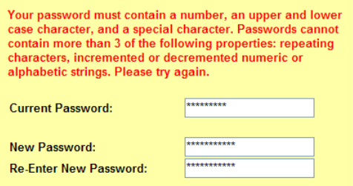
Password complexity requirements don’t help
Most people use similar patterns (i.e. capital letter in the first position, a symbol in the last, and a number in the last two).
Example: Copenh@gen47
Cybercriminals run their dictionary attacks using the common substitutions, such as "$" for "s", "@" for "a," "1" for "l" and so on.
@RonniPedersen

Slide 27
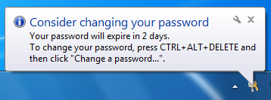
Password expiry does more harm than good
Users who are required to change their passwords frequently select weaker passwords to begin with.
Users do not choose a new independent password; rather, they choose an update of the old one.
Example:
Copenh@gen42
Copenh@gen43
Copenh@gen44
@RonniPedersen

Slide 28
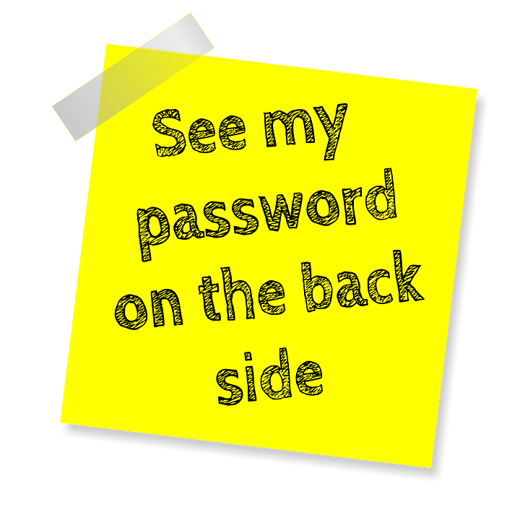
Longer passwords are not necessarily better
Users who are required to have a 16-character password tend to choose repeating patterns like fourfourfourfour or passwordpassword.
Length requirements increase the chance of users:
Writing their passwords down
Re-using passwords
Storing them unencrypted on their PC
@RonniPedersen

Slide 29
Multi-factor authentication

Slide 30

Modern Authentication
Modern Authentication is the key to success when activating MFA !!!
Turned off for Exchange Online by default.
Turned on for SharePoint Online by default.
Turned off for Skype for Business Online by default.
OFF = App Password (Bad End User Experience)
Enable modern authentication for Skype for Business Online
https://www.ronnipedersen.com/2017/07/11/enable-modern-authentication-for-skype-for-business-online/
@RonniPedersen

Slide 31
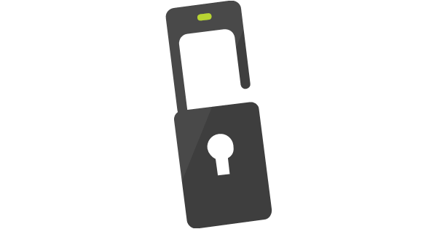
Modern Authentication - Exchange Online
Enables authentication features like
Multi-factor authentication (MFA) using smart cards
Certificate-based authentication (CBA)
Third-party SAML identity providers
Modern authentication is based on the ADAL and OAuth 2.0
Set-OrganizationConfig -OAuth2ClientProfileEnabled $true
@RonniPedersen

Slide 32
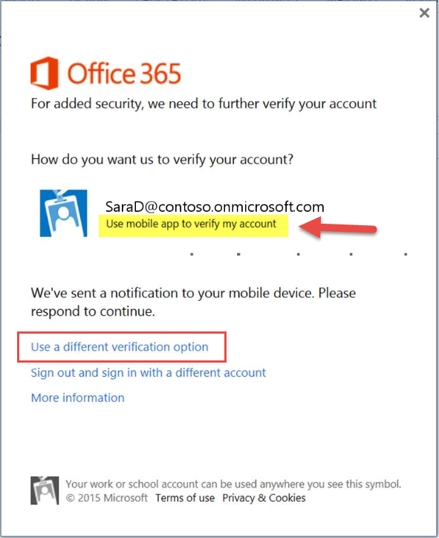
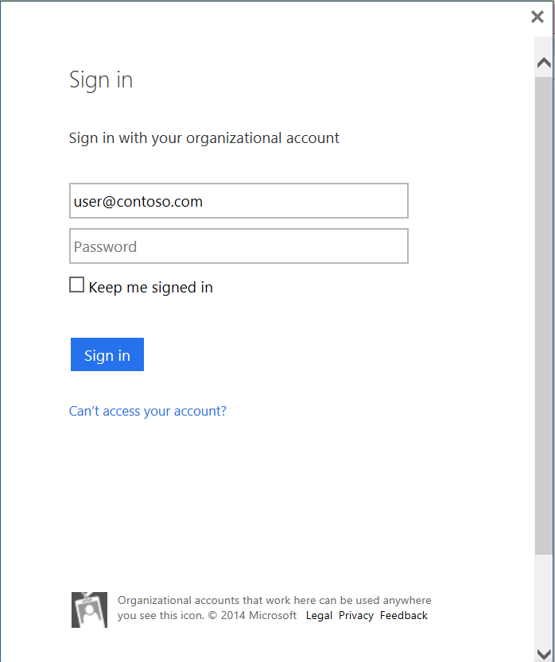
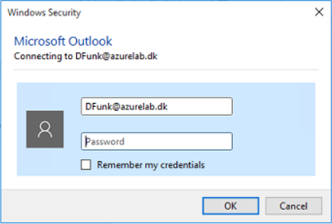
Basic vs. Modern Authentication
@RonniPedersen

Slide 33
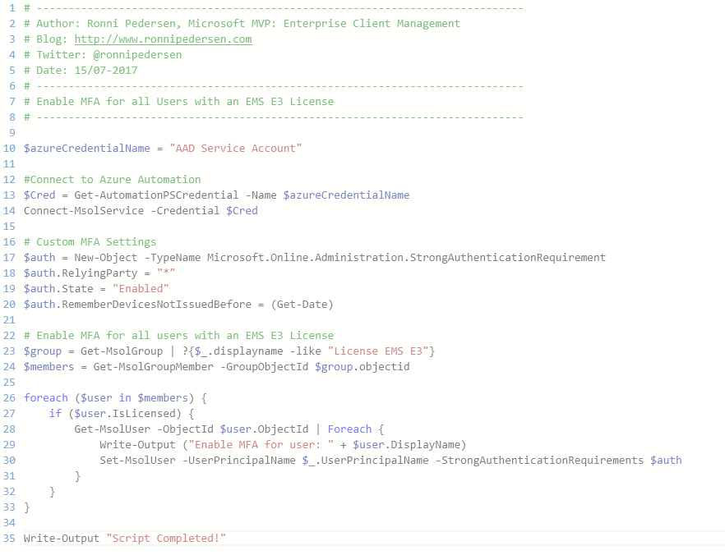
Azure Automation (Runbook) - Enable Azure MFA
Runbook Overview
Connect to the Tenant
Set Custom MFA Settings
Get all users with a license
Enable MFA for the user
Schedule Recommendation:
Every day
@RonniPedersen

Slide 34
Secure Guest Access with Azure MFA
Require MFA using Conditional Access

Slide 35
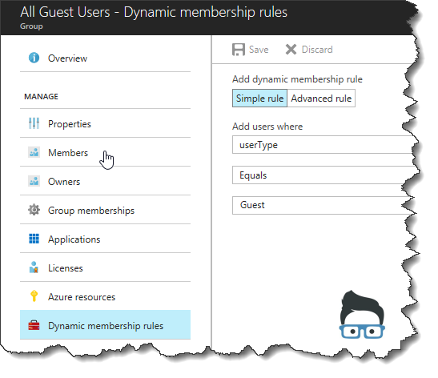
Identify External Guest Users
Azure AD Group
Dynamic Membership
userType Equals Guest
@RonniPedersen
© RONNIPEDERSEN.COM
35

Slide 36
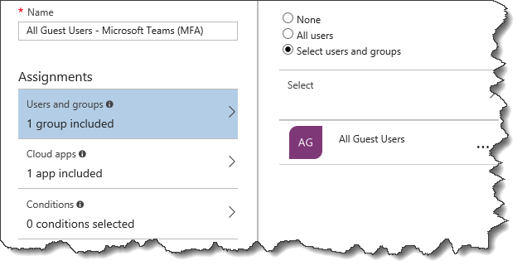
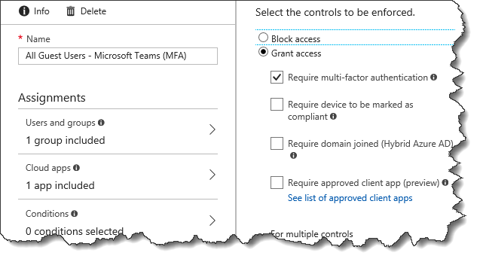
Require MFA for Guest Users
Conditional Access Rule
All Guest Users
Microsoft Teams
Require MFA
@RonniPedersen
36

Slide 37
Conditional Access

Slide 38
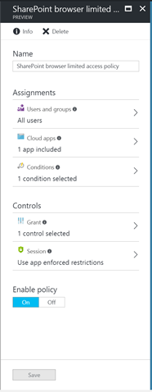
“Limited Access” - SharePoint and OneDrive
Enabling productivity while securing data
Secure, Productive Enterprise
Allow access to SharePoint and OneDrive
Unmanaged Device
Browser-Only Access
Download, Print, and Sync Disabled
@RonniPedersen

Slide 39

Device Registration / Compliant
DJ++
Hybrid Identity (Domain Joined + Device Registered in Azure AD)
Azure AD Joined
Cloud Only (Azure AD Joined)
Workplace Joined
”Workgroup” (No Domain or Azure AD Joined)
@RonniPedersen
39

Slide 40
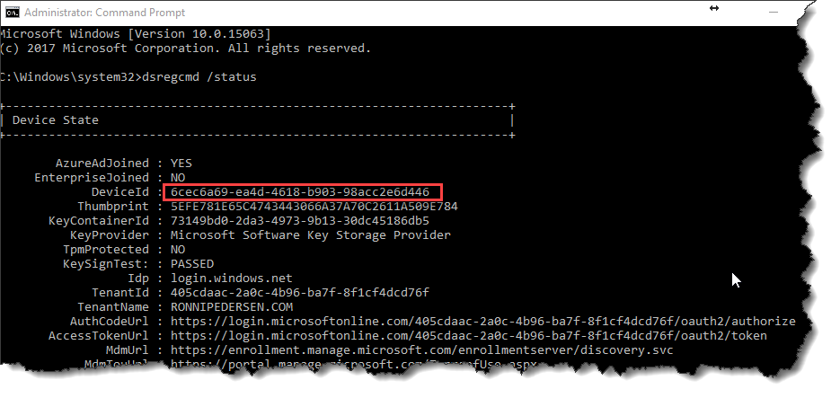
Azure AD Joined (Example)
Command: dsregcmd /status
My Work PC: 6cec6a69-ea4d-4618-b903-98acc2e6d446
@RonniPedersen

Slide 41
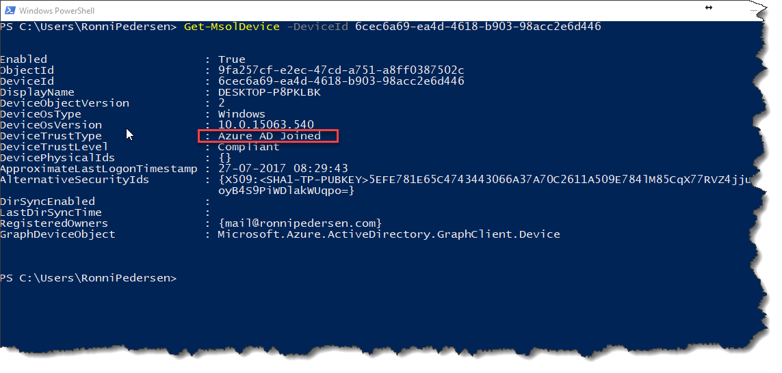
Device Trust Type
@RonniPedersen
41

Slide 42

Thank you!

